Slide 1
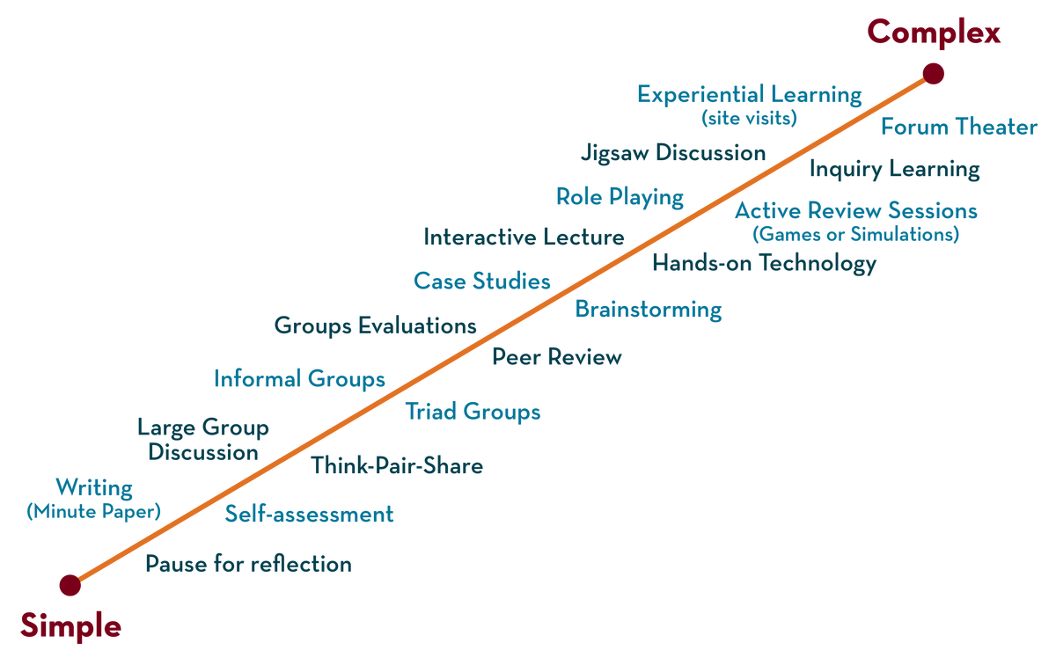
COURSE NAME : Operating Systems COURSE CODE: 21CS2109RA
CO2
Session - 1
Introduction to MEMORY MANAGEMENT,
Address space, memory api

Slide 2
AIM OF THE SESSION
To familiarize students with the basic concept of memory management of Operating System
INSTRUCTIONAL OBJECTIVES
This Session is designed to:
What is Memory Virtualization
Describe what is memory management of operating system
List out the steps involved in allocation and managing of memory
Describe the role of Address Space in operating system
A Case Study of Address Space and Memory Space
LEARNING OUTCOMES
At the end of this session, you should be able to:
Defines Memory Virtualization, Address Space, Memory API
Describe what is Memory Management of operating systems,
Summarize Role of Address Space and Memory API concepts of memory management in Operating System along with different functions.

Slide 3
SESSION DESCRIPTION
What is Memory Management in Operating System?
Description of Virtual Memory in Memory Management
Role of Swapping
Understands Multi-Programming and Address Space
Describe Types of Memory with respect to Memory API
Discuss the common errors that arise in the use of malloc() and free().

Slide 4
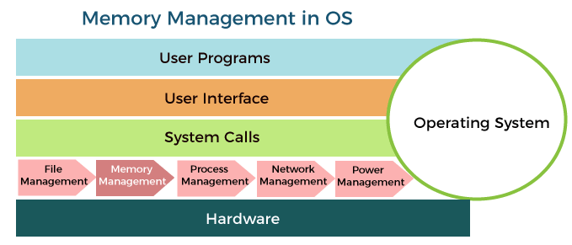
What is Memory Management?

Slide 5
What is Memory Management?
Memory is the important part of the computer that is used to store the data. Its management is critical to the computer system because the amount of main memory available in a computer system is very limited.
At any time, many processes are competing for it. Moreover, to increase performance, several processes are executed simultaneously.
For this, we must keep several processes in the main memory, so it is even more important to manage them effectively.

Slide 6
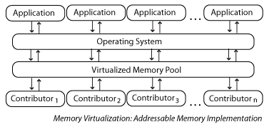
What is Memory Virtualization?

Slide 7
What is Memory Virtualization?
Memory virtualization decouples volatile Random Access Memory (RAM) resources from individual systems in the data center, and then aggregates those resources into a virtualized memory pool available to any computer in the cluster.
The memory pool is accessed by the operating system or applications running on top of the operating system.
The distributed memory pool can then be utilized as a high-speed cache, a messaging layer, or a large, shared memory resource for a CPU or a GPU application.

Slide 8
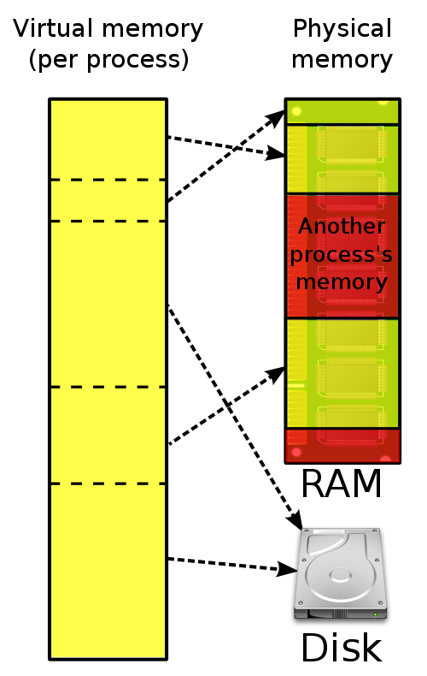
Virtual Memory is a technique of executing program instructions that may not fit entirely in the system memory.
OS virtualizes its physical memory.
OS provides an illusion memory space per each process.
It seems to be seen like each process uses the whole memory .
Virtual Memory is a technique of executing Program instructions that may not fit entirely in the system memory.

Slide 9
ADDRESS SPACE
What is an address space?
The range of virtual addresses that the operating system assigns to a user or separately running program is called an address space. This is the area of contiguous virtual addresses available for executing instructions and storing data
A computer's address space is the total amount of memory that can be addressed by the computer. The term may refer to the physical memory (RAM chips) or virtual memory (disk/SSD).

Slide 10
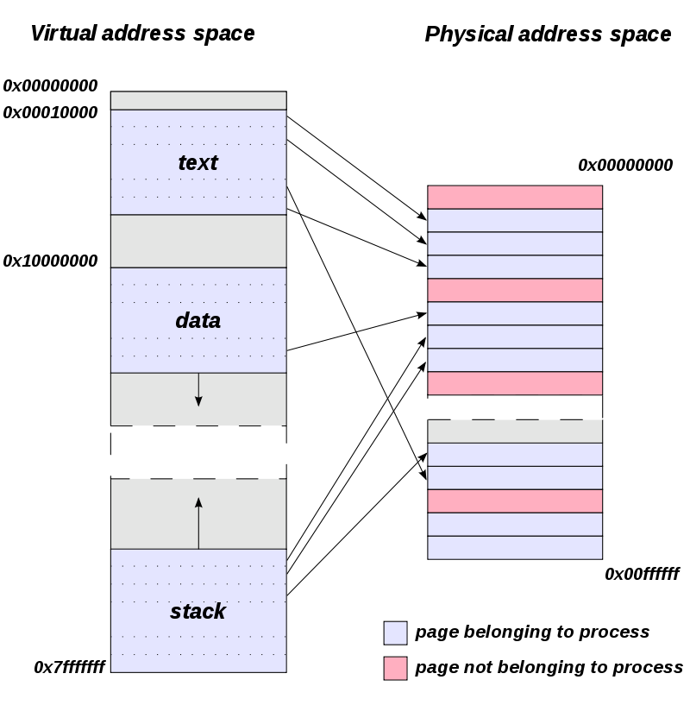

Slide 11
SWAPPING
SWAPPING is the Process of temporarily removing inactive programs from the main memory of a computer system.
Swapping is a mechanism in which a process can be swapped temporarily out of main memory (or move) to secondary storage (Disk) and make that memory available to other processes.
At some later time, the system swaps back the process from the secondary storage to main memory.

Slide 12
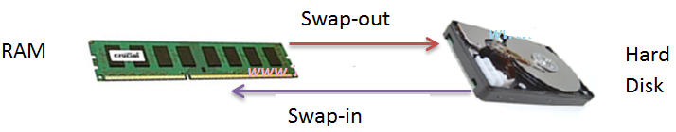

Slide 13
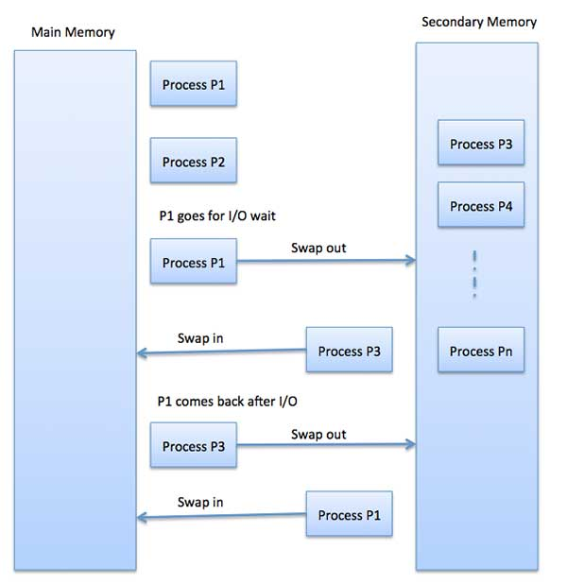

Slide 14
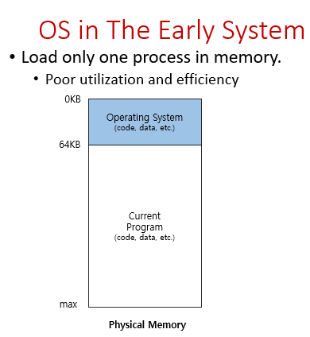
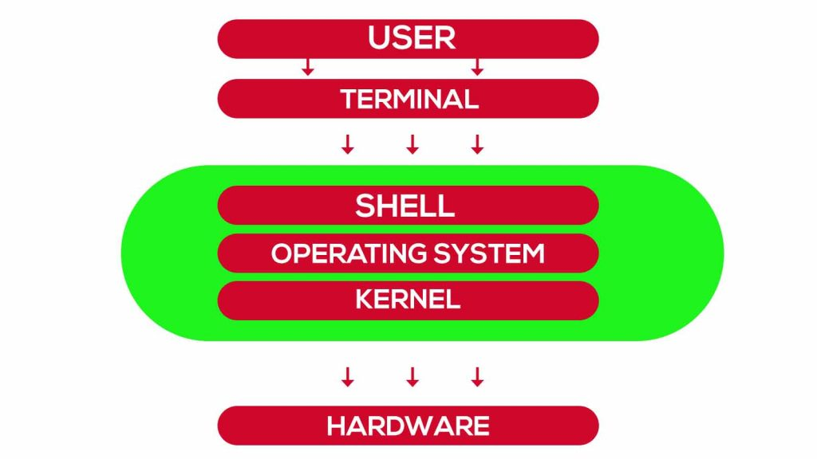
Standard Operating System

Slide 15
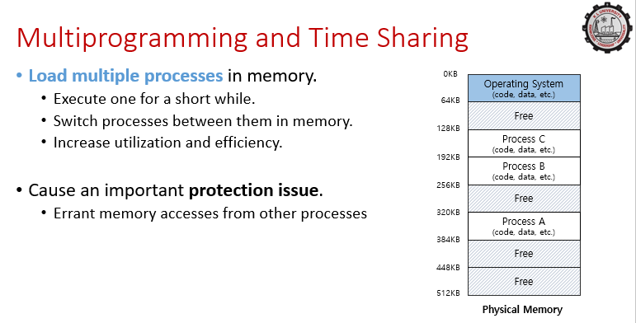

Slide 16
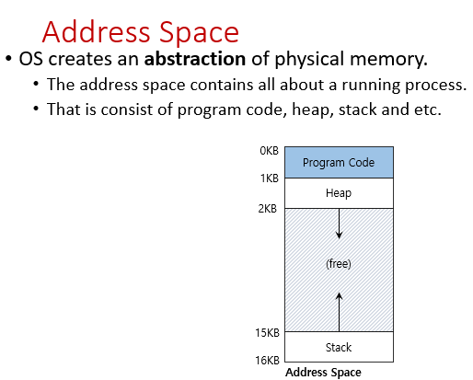
ADDRESS SPACE

Slide 17
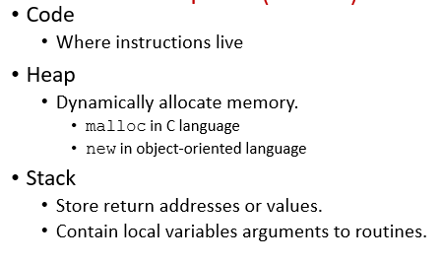
ADDRESS SPACE
Address space is an important concept in the operating system. It is the volume of memory which is allocated for all the potential addresses associated with a computational unit such as a file, a device, a networked computer system, or a server.

Slide 18
Virtual Address
Every address in a running program is virtual.
OS translates the virtual address to physical address

Slide 19
#include <stdio.h>
#include <stdlib.h>
int main(int argc, char *argv[]){
printf("location of code : %p\n", (void *) main);
printf("location of heap : %p\n", (void *) malloc(1));
int x = 3;
printf("location of stack : %p\n", (void *) &x);
return x;
}

Slide 20
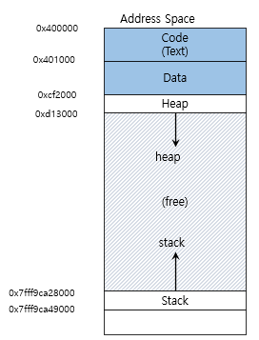
A simple program that prints out addresses
The output in 64-bit Linux machine
location of code : 0x40057d
location of heap : 0xcf2010
location of stack : 0x7fff9ca45fcc

Slide 21
Memory API - Types of Memory
In running a C program, there are two types of memory that are allocated.
The first is called stack memory, and allocations and de-allocations of it are managed implicitly by the compiler for you, the programmer; for this reason it is sometimes called automatic memory.

Slide 22
Memory API - Types of Memory
Declaring memory on the stack in C is easy. For example, let’s say you need some space in a function func() for an integer, called x. To declare such a piece of memory, the snippet is :
void func()
{
int x; // declares an integer on the stack
...
} The compiler does the rest, making sure to make space on the stack when you call into func().

Slide 23
Memory API - Types of Memory
Second type of memory, called heap memory, where all allocations and de-allocations are explicitly handled by you, the programmer.
Here is an example of how one might allocate an integer on the heap:
void func()
{
int *x = (int *) malloc(sizeof(int));
...
}

Slide 24
Memory API - Types of Memory
First, you might notice that both stack and heap allocation occur on this line: first the compiler knows to make room for a pointer to an integer when it sees your declaration of said pointer (int *x); subsequently, when the program calls malloc(), it requests space for an integer on the heap; the routine returns the address of such an integer (upon success, or NULL on failure), which is then stored on the stack for use by the program.

Slide 25
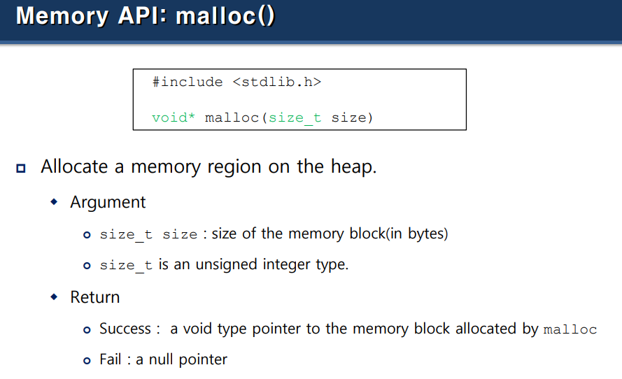
MEMORY MANAGEMENT – MEMORY API

Slide 26
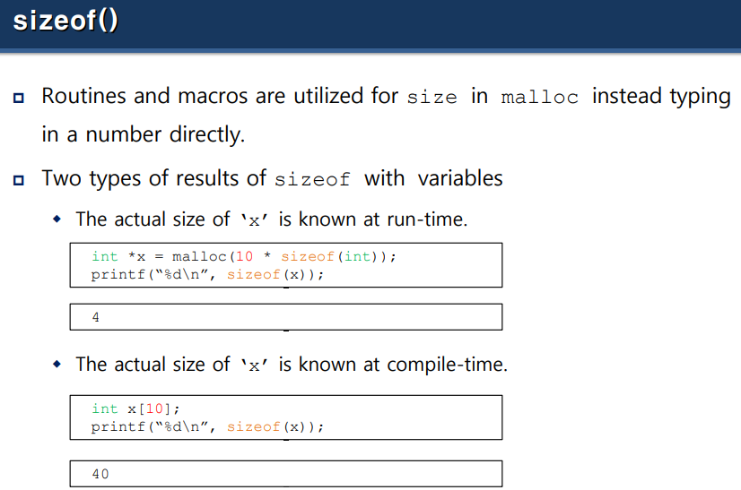

Slide 27
Sizeof()
When sizeof() is used with the data types such as int, float, char… etc it simply returns the amount of memory is allocated to that data types.

Slide 28
#include <stdio.h>
int main()
{
printf("%lu\n", sizeof(char));
printf("%lu\n", sizeof(int));
printf("%lu\n", sizeof(float));
printf("%lu", sizeof(double));
return 0;
}
Output:1 4 4 8

Slide 29
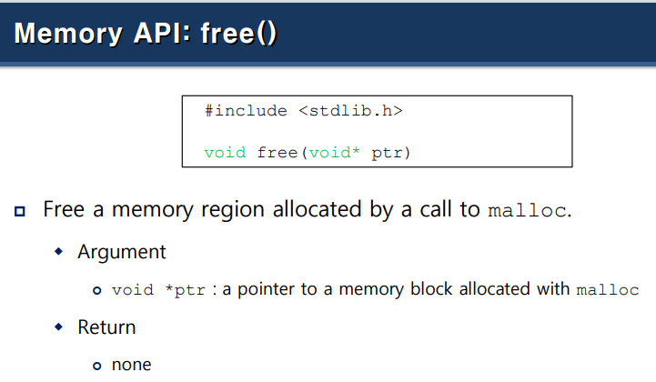
MEMORY API – free()

Slide 30
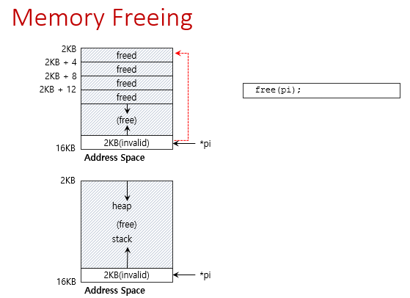

Slide 31
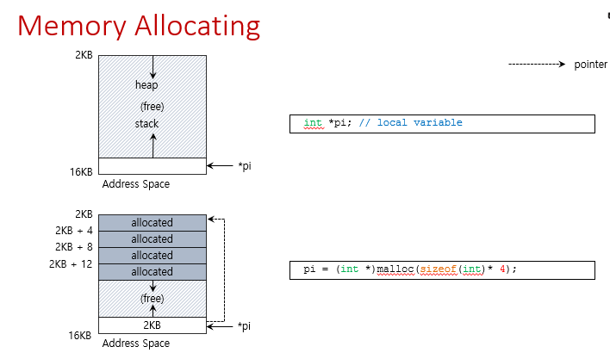

Slide 32
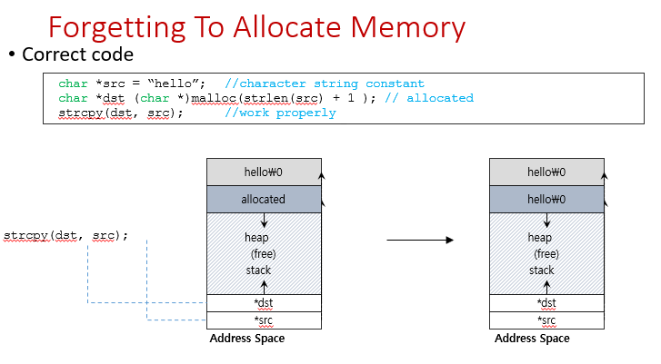

Slide 33
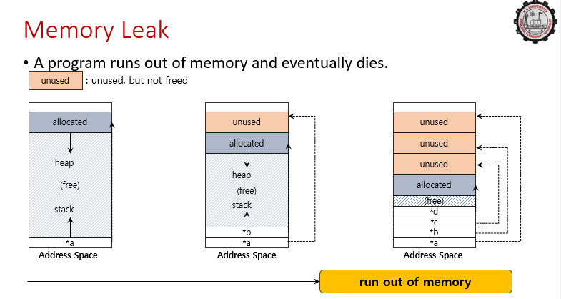

Slide 34
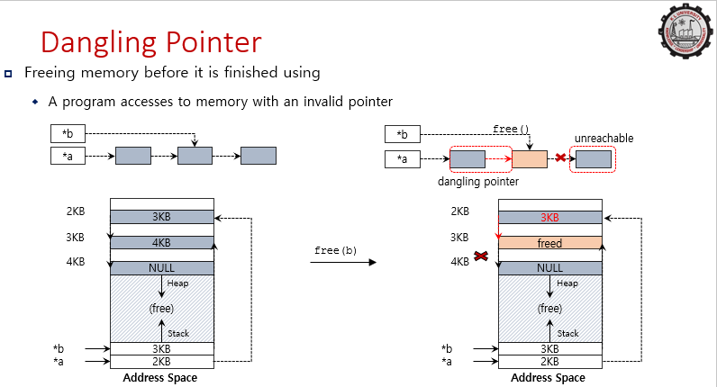

Slide 35
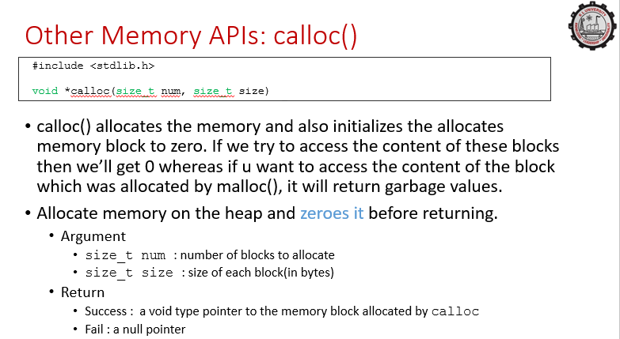

Slide 36
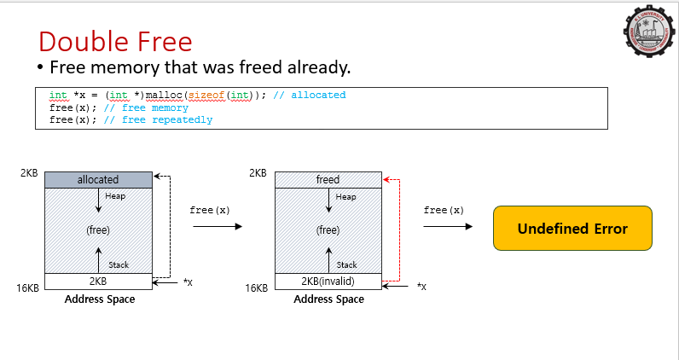

Slide 37
DOUBLE FREE
Programs also sometimes free memory more than once; this is known as the double free.
The result of doing so is undefined.
As you can imagine, the memory-allocation library might get confused and do all sorts of weird things; crashes are a common outcome.

Slide 38
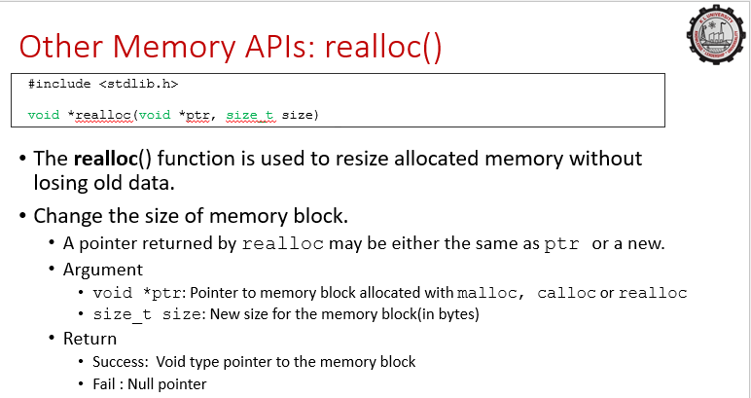
Memory APIs: realloc()

Slide 39
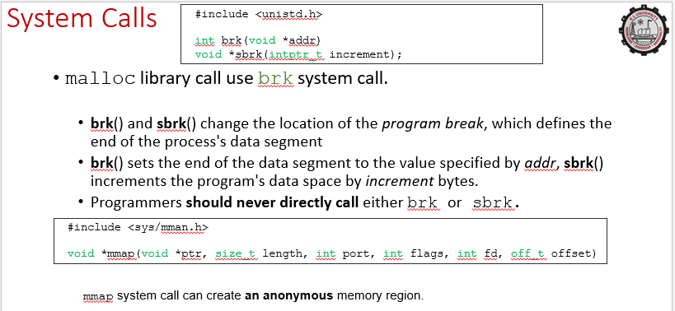

Slide 40
SUMMARY
In running a C program, there are two types of memory that are allocated. The first is called stack memory, and allocations and deallocations of it are managed implicitly by the compiler for you, the programmer; for this reason it is sometimes called automatic memory. It is this need for long-lived memory that gets us to the second type of memory, called heap memory, where all allocations and deallocations are explicitly handled by you, the programmer. A heavy responsibility, no doubt! And certainly the cause of many bugs. But if you are careful and pay attention, you will use such interfaces correctly and without too much trouble. The malloc() call is quite simple: you pass it a size asking for some room on the heap, and it either succeeds and gives you back a pointer to the newly-allocated space, or fails and returns NULL. As it turns out, allocating memory is the easy part of the equation; knowing when, how, and even if to free memory is the hard part. To free heap memory that is no longer in use, programmers simply call free():

Slide 41
SUMMARY
There are a number of common errors that arise in the use of malloc() and free().
Forgetting To Allocate Memory
Not Allocating Enough Memory
Forgetting to Initialize Allocated Memory
Forgetting To Free Memory
Freeing Memory Before You Are Done With It
Freeing Memory Repeatedly
Calling free() Incorrectly
There are a few other calls that the memory-allocation library supports. For example, calloc() allocates memory and also zeroes it before returning; this prevents some errors where you assume that memory is zeroed and forget to initialize it yourself (see the paragraph on “uninitialized reads” above). The routine realloc() can also be useful, when you’ve allocated space for something (say, an array), and then need to add something to it: realloc() makes a new larger region of memory, copies the old region into it, and returns the pointer to the new region.

Slide 42
REFERENCES FOR FURTHER LEARNING OF THE SESSION
Reference Books:
1. Arpaci-Dusseau, Remzi H., and Andrea C. Arpaci-Dusseau. Operating systems: Three easy pieces. Boston: Arpaci-Dusseau Books LLC, 2018. http://pages.cs.wisc.edu/~remzi/OSTEP/
Silberschatz, Abraham, Peter B. Galvin, and Greg Gagne. Operating system concepts. 10th edition, John Wiley & Sons, 2018.
Tanenbaum, Andrew. Modern operating systems. Pearson Education, Inc., 2009.
Sites and Web links:
https://www.cse.iitb.ac.in/~mythili/os/
https://cse.iitkgp.ac.in/~sumantra/courses/os/os_pg.html
https://www.cse.iitd.ernet.in/os-lectures

Slide 43

THANK YOU
Team – Operating System

